Slide 1
Inefficient Waste Management
DHAIRYA GOEL
E22BCAU0123
J.CHANDRAMSH PATEL
E22BCAU0006
CHIRAG JAIN
E22BCAU0016
HARTEJ SINGH
E22BCAU0045
MOKSH DHADWAL
E22BCAU0011

Slide 2
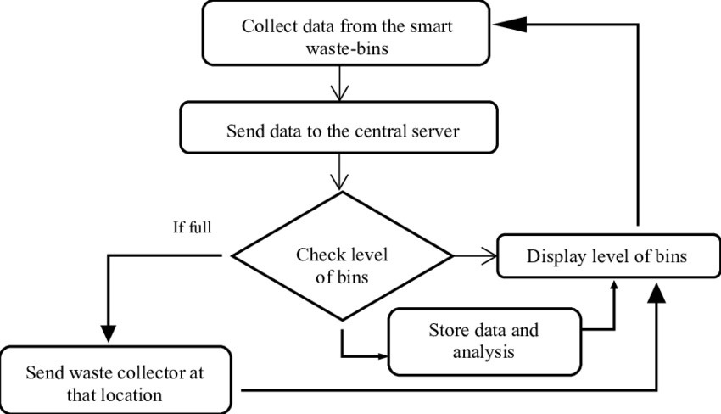
Activity Diagram
/02

Slide 3
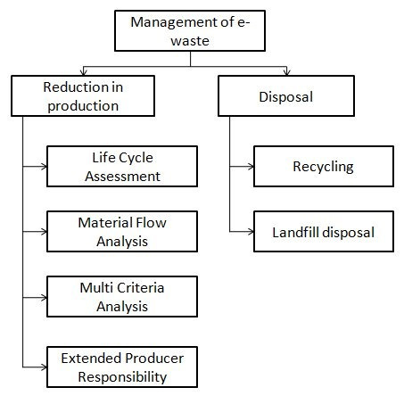
Activity Diagram

Slide 4
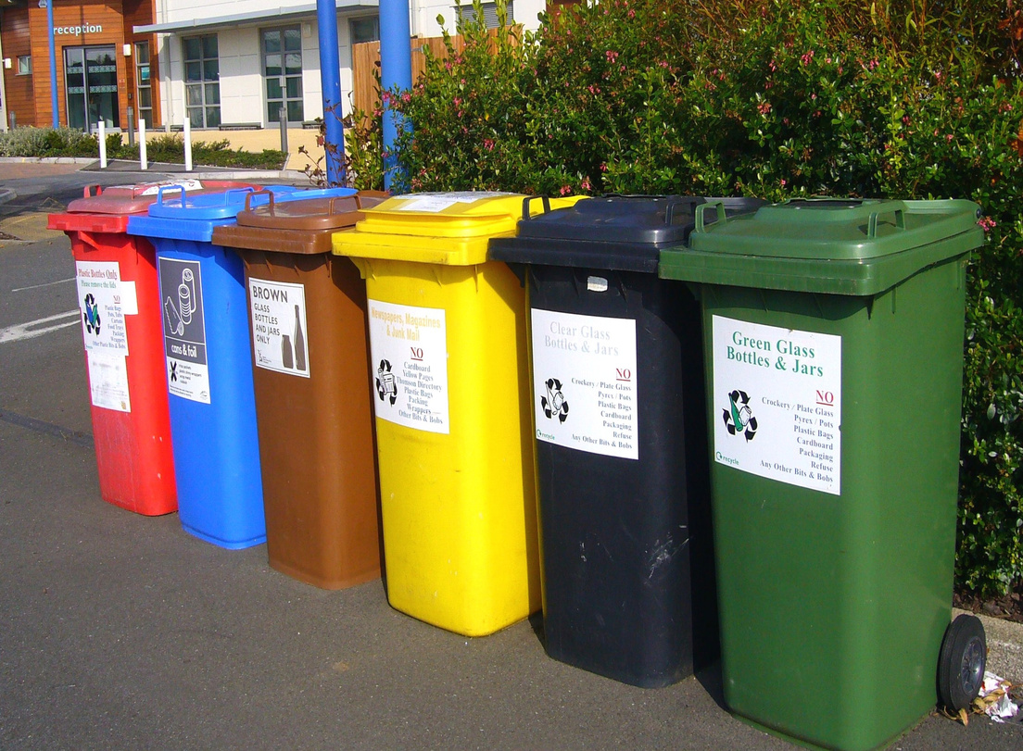
/03
WEEK 1
Assessment and Inventory.
Collection and Storage
Vendor Partnerships

Slide 5
/03
WEEK 2
1.Frontend:
(HTML,JAVA,CSS)

